Slide 1
Complex Wavelet Transform based Denoising

Slide 2
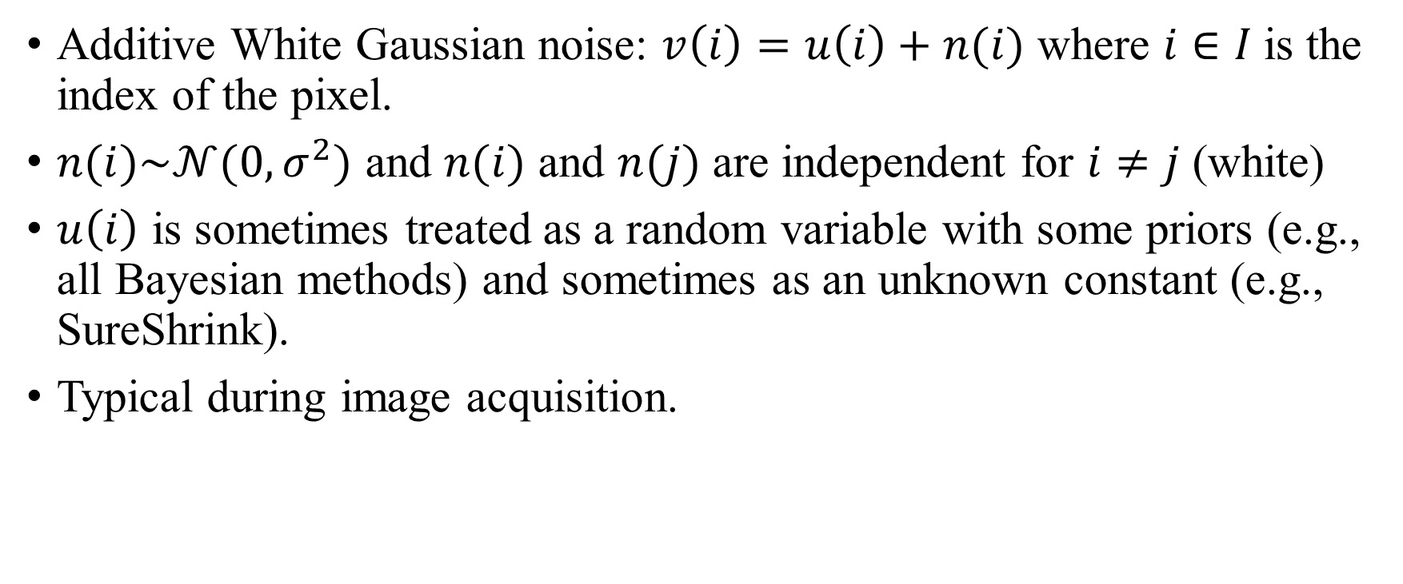
Noise model:
Additive White Gaussian noise: $v\left(i\right)=u\left(i\right)+n(i)$ where $i∈I$is the index of the pixel.
$n(i)\sim 𝒩(0,σ^{2})$ and $n(i)$ and $n(j)$ are independent for $i≠j$ (white)
$u\left(i\right)$ is sometimes treated as a random variable with some priors (e.g., all Bayesian methods) and sometimes as an unknown constant (e.g., SureShrink).
Typical during image acquisition.

Slide 3
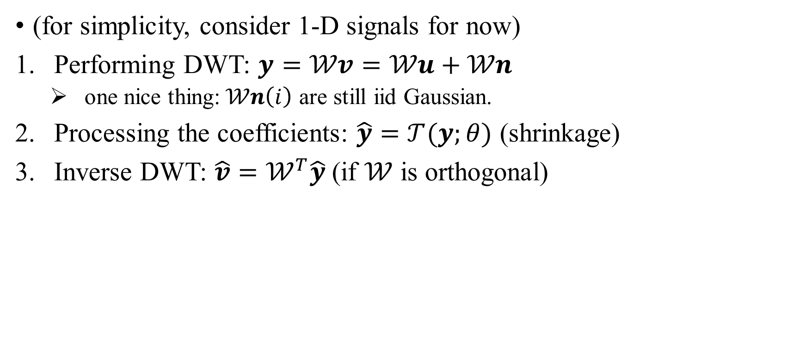
Typical wavelet denoising procedure
(for simplicity, consider 1-D signals for now)
Performing DWT: $y=𝒲v=𝒲u+𝒲n$
one nice thing:$𝒲n\left(i\right)$ are still iid Gaussian.
Processing the coefficients: $\hat{y}=𝒯(y;θ)$ (shrinkage)
Inverse DWT: $\hat{v}=𝒲^{T}\hat{y}$ (if $𝒲$ is orthogonal)

Slide 4
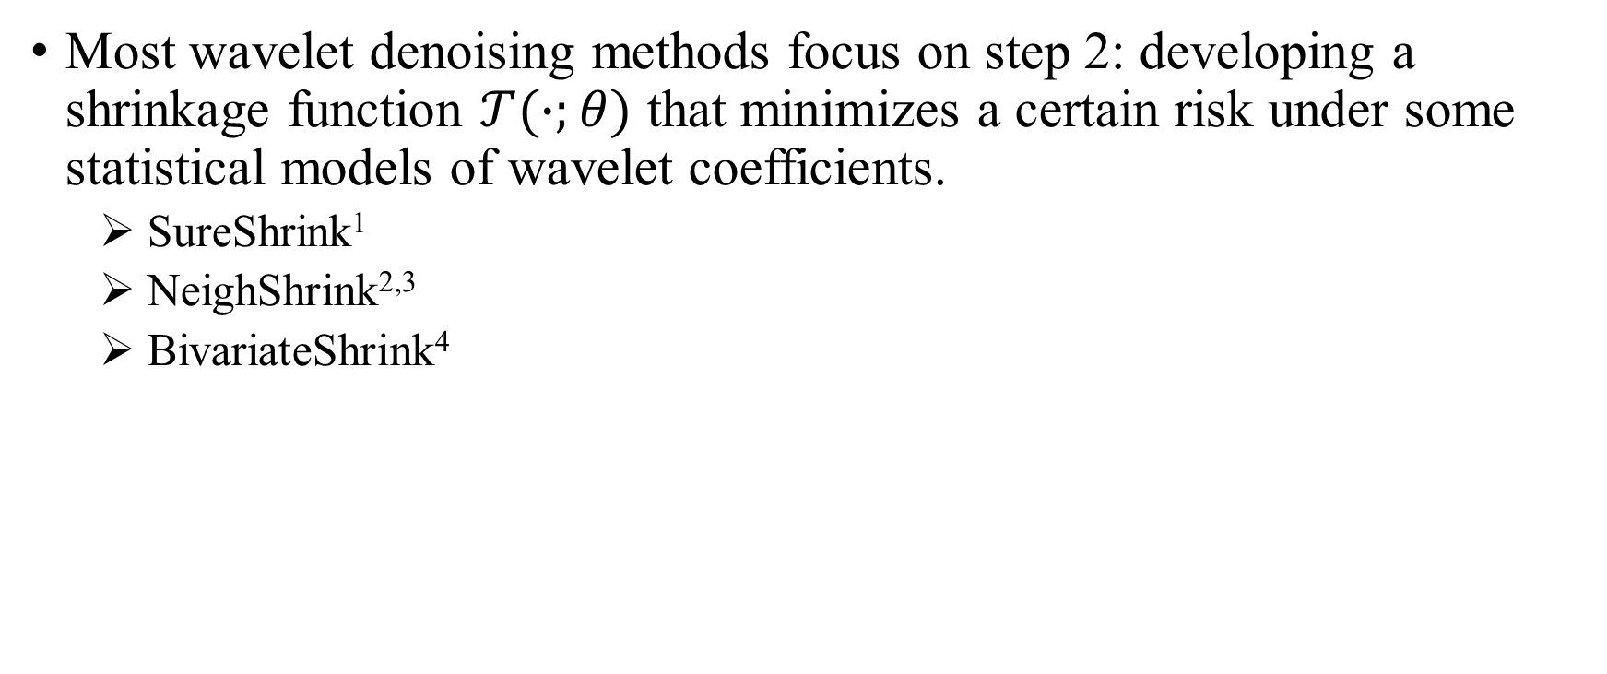
Most wavelet denoising methods focus on step 2: developing a shrinkage function $𝒯(∙;θ)$ that minimizes a certain risk under some statistical models of wavelet coefficients.
SureShrink¹
NeighShrink^{2,3}
BivariateShrink⁴

Slide 5
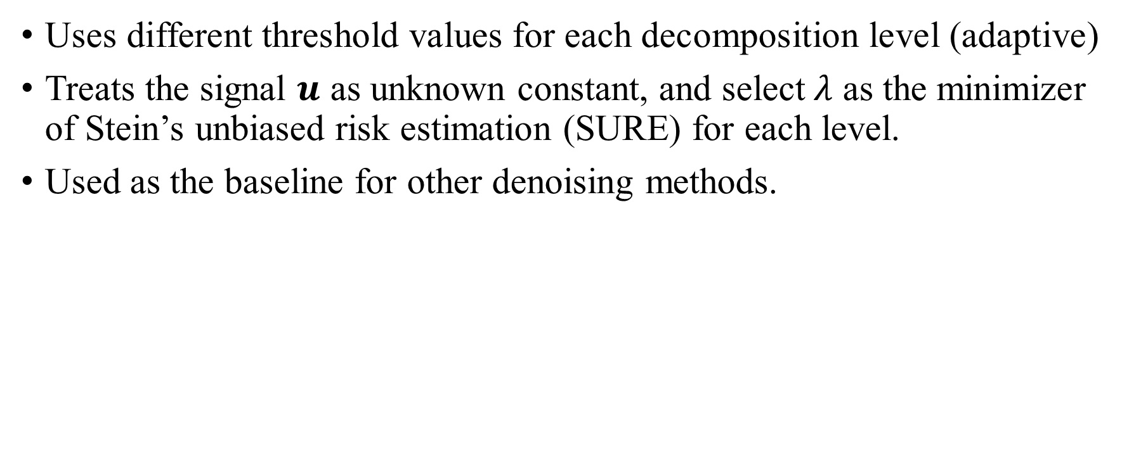
SureShrink
Uses different threshold values for each decomposition level (adaptive)
Treats the signal $u$ as unknown constant, and select$λ$ as the minimizer of Stein’s unbiased risk estimation (SURE) for each level.
Used as the baseline for other denoising methods.

Slide 6
NeighShrink
SureShrink shrinks coefficients term by term, but we can instead incorporate intra-level neighboring information to the thresholding of pixel of current interest.
Based on the observation that in a detail subband, if a coefficient is surrounded by large coefficients, then it is more likely coming from the high-frequency features of the image: edges and contours.
Uses the universal threshold proposed by Donoho as the initial threshold, and adjust it according to the sum of squares of the coefficients in the neighbour -> large neighboring values, less shrinkage.

Slide 7
Bivariate Shrink

Slide 8
So far only considered step 2. What about step 1&3?
Can use other transforms that better represent critical features of the image.

Slide 9
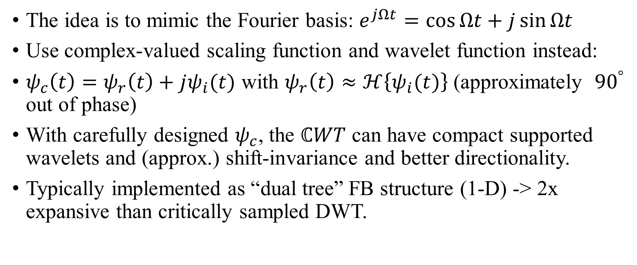
Complex wavelet transform¹
The idea is to mimic the Fourier basis: $e^{jΩt}=\cos{Ωt}+j\sin{Ωt}$
Use complex-valued scaling function and wavelet function instead:
$ψ_{c}\left(t\right)=ψ_{r}\left(t\right)+jψ_{i}(t)$ with $ψ_{r}\left(t\right)≈ℋ\left\{ψ_{i}(t)\right\}$ (approximately ${90}^{°}$ out of phase)
With carefully designed $ψ_{c}$, the $ℂWT$ can have compact supported wavelets and (approx.) shift-invariance and better directionality.
Typically implemented as “dual tree” FB structure (1-D) -> 2x expansive than critically sampled DWT.

Slide 10
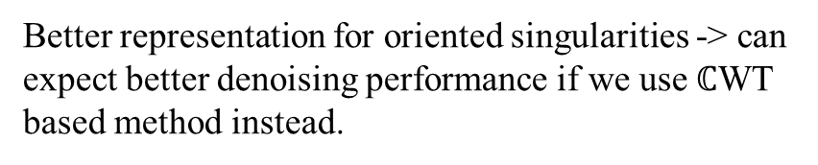
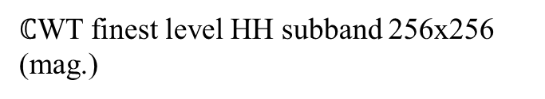
Original image 512x512
$ℂ$WT finest level HH subband 256x256 (mag.)
Better representation for oriented singularities -> can expect better denoising performance if we use $ℂ$WT based method instead.
Critically sampled DWT finest level HH subband 256x256 (db4)

Slide 11
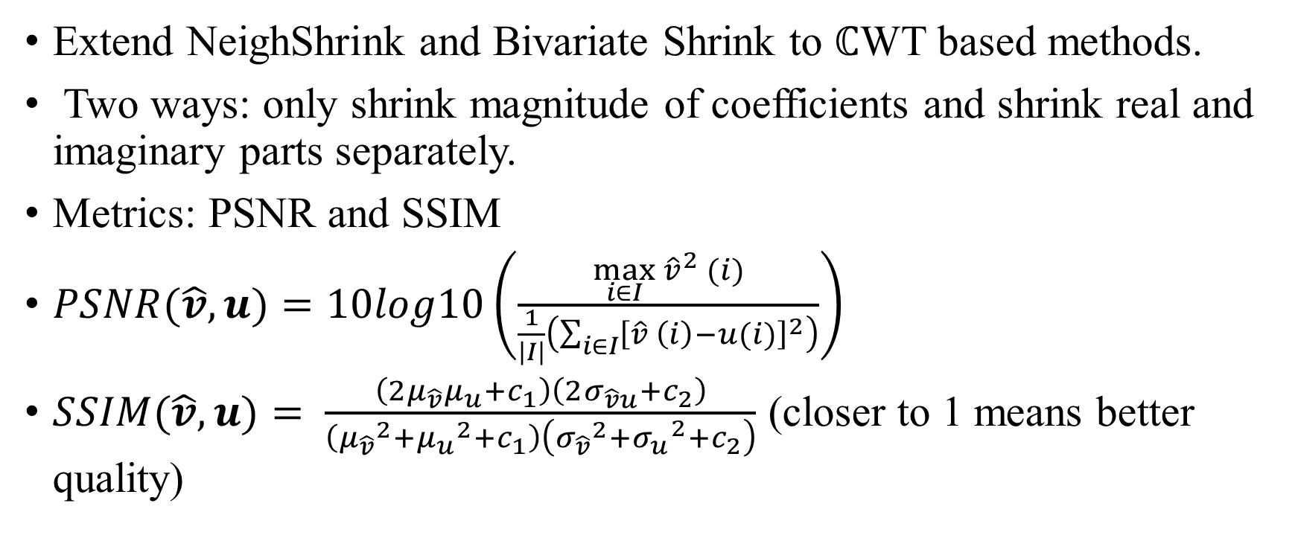
Extend NeighShrink and Bivariate Shrink to $ℂ$WT based methods.
Two ways: only shrink magnitude of coefficients and shrink real and imaginary parts separately.
Metrics: PSNR and SSIM
$PSNR(\hat{v},u)=10log10\left(\frac{\max_{i∈I}{{\hat{v}}^{2} (i)}}{\frac{1}{\left|I\right|}\left(\sum_{i∈I}{{\left[\hat{v} \left(i\right)−u(i)\right]}^{2}}\right)}\right)$
$SSIM(\hat{v},u)= \frac{\left(2μ_{\hat{v}}μ_{u}+c_{1}\right)\left(2σ_{\hat{v}u}+c_{2}\right)}{\left({μ_{\hat{v}}}^{2}+{μ_{u}}^{2}+c_{1}\right)\left({σ_{\hat{v}}}^{2}{{+σ}_{u}}^{2}+c_{2}\right)}$ (closer to 1 means better quality)

Slide 12
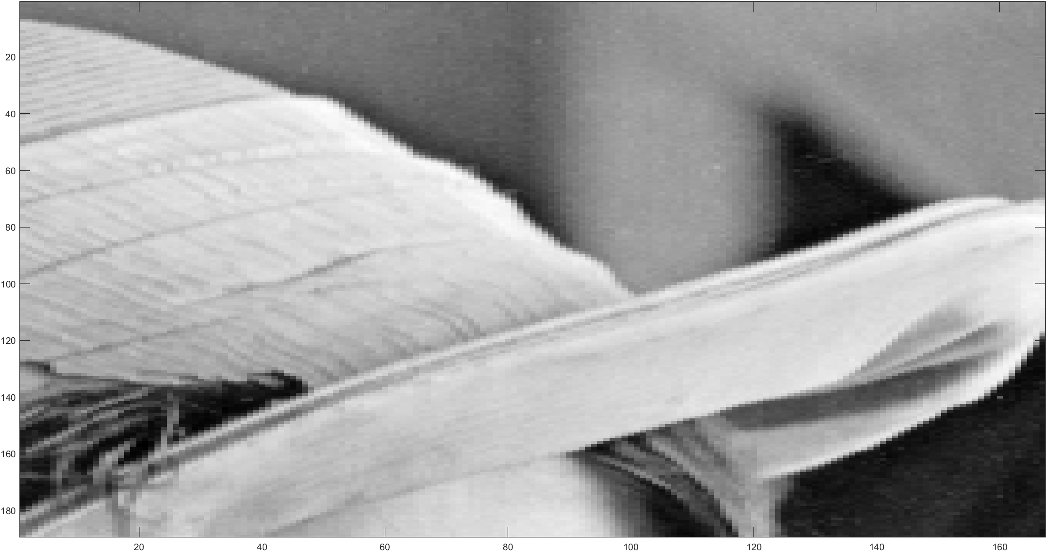
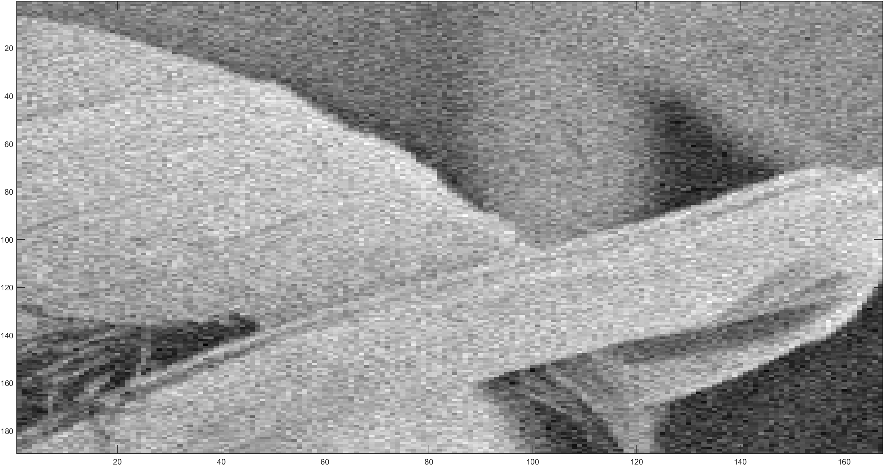
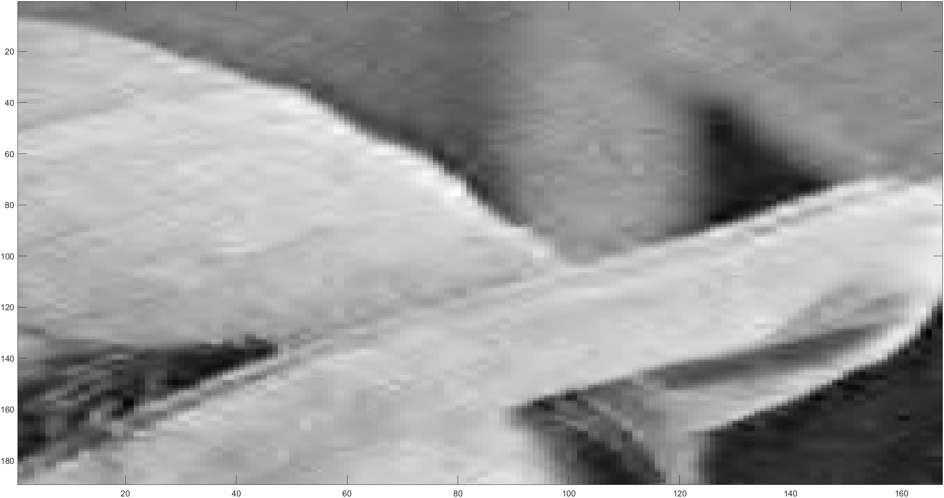



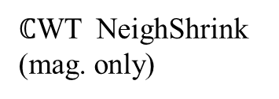
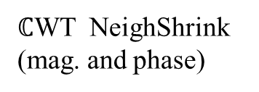
PSNR: 22.12
SSIM: 0.34
Noise std: 20
PSNR: 30.08
SSIM: 0.80
Original image
Noisy image
SureShrink
PSNR: 30.83
SSIM: 0.81
PSNR: 32.27
SSIM: 0.86
PSNR: 31.90
SSIM: 0.84
NeighShrink
$ℂ$WT NeighShrink (mag. only)
$ℂ$WT NeighShrink (mag. and phase)
Lena

Slide 13
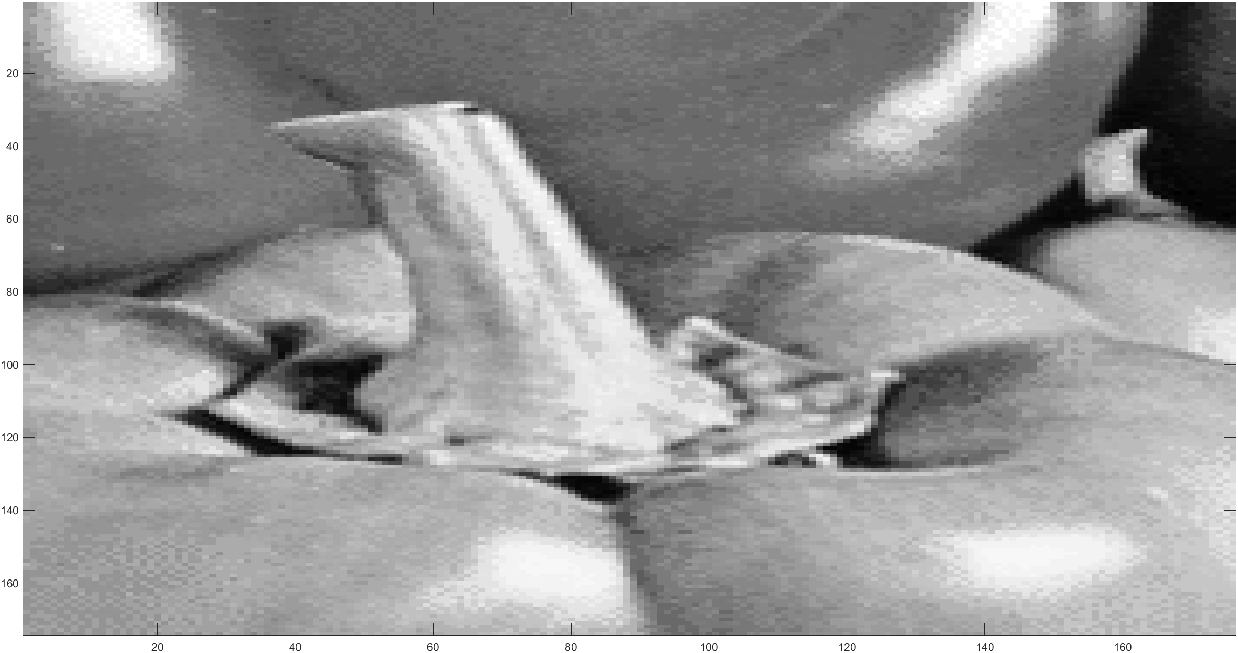
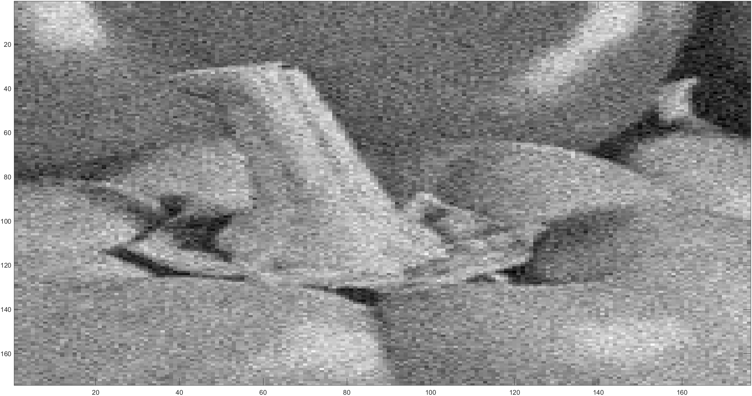

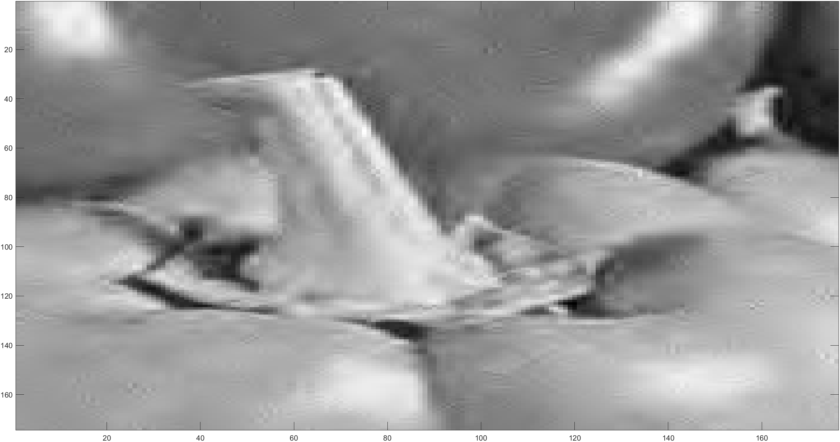


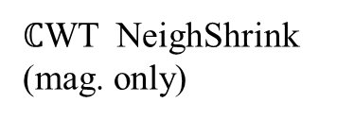
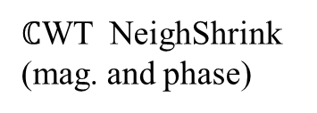
PSNR: 22.12
SSIM: 0.35
Noise std: 20
PSNR: 29.84
SSIM: 0.75
Original image
Noisy image
SureShrink
PSNR: 30.36
SSIM: 0.76
PSNR: 31.39
SSIM: 0.79
PSNR: 31.15
SSIM: 0.78
NeighShrink
$ℂ$WT NeighShrink (mag. only)
$ℂ$WT NeighShrink (mag. and phase)
Peppers

Slide 14
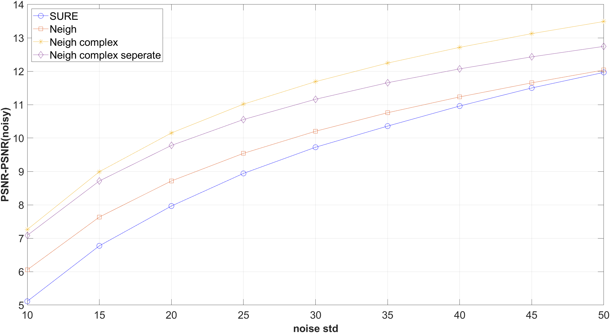
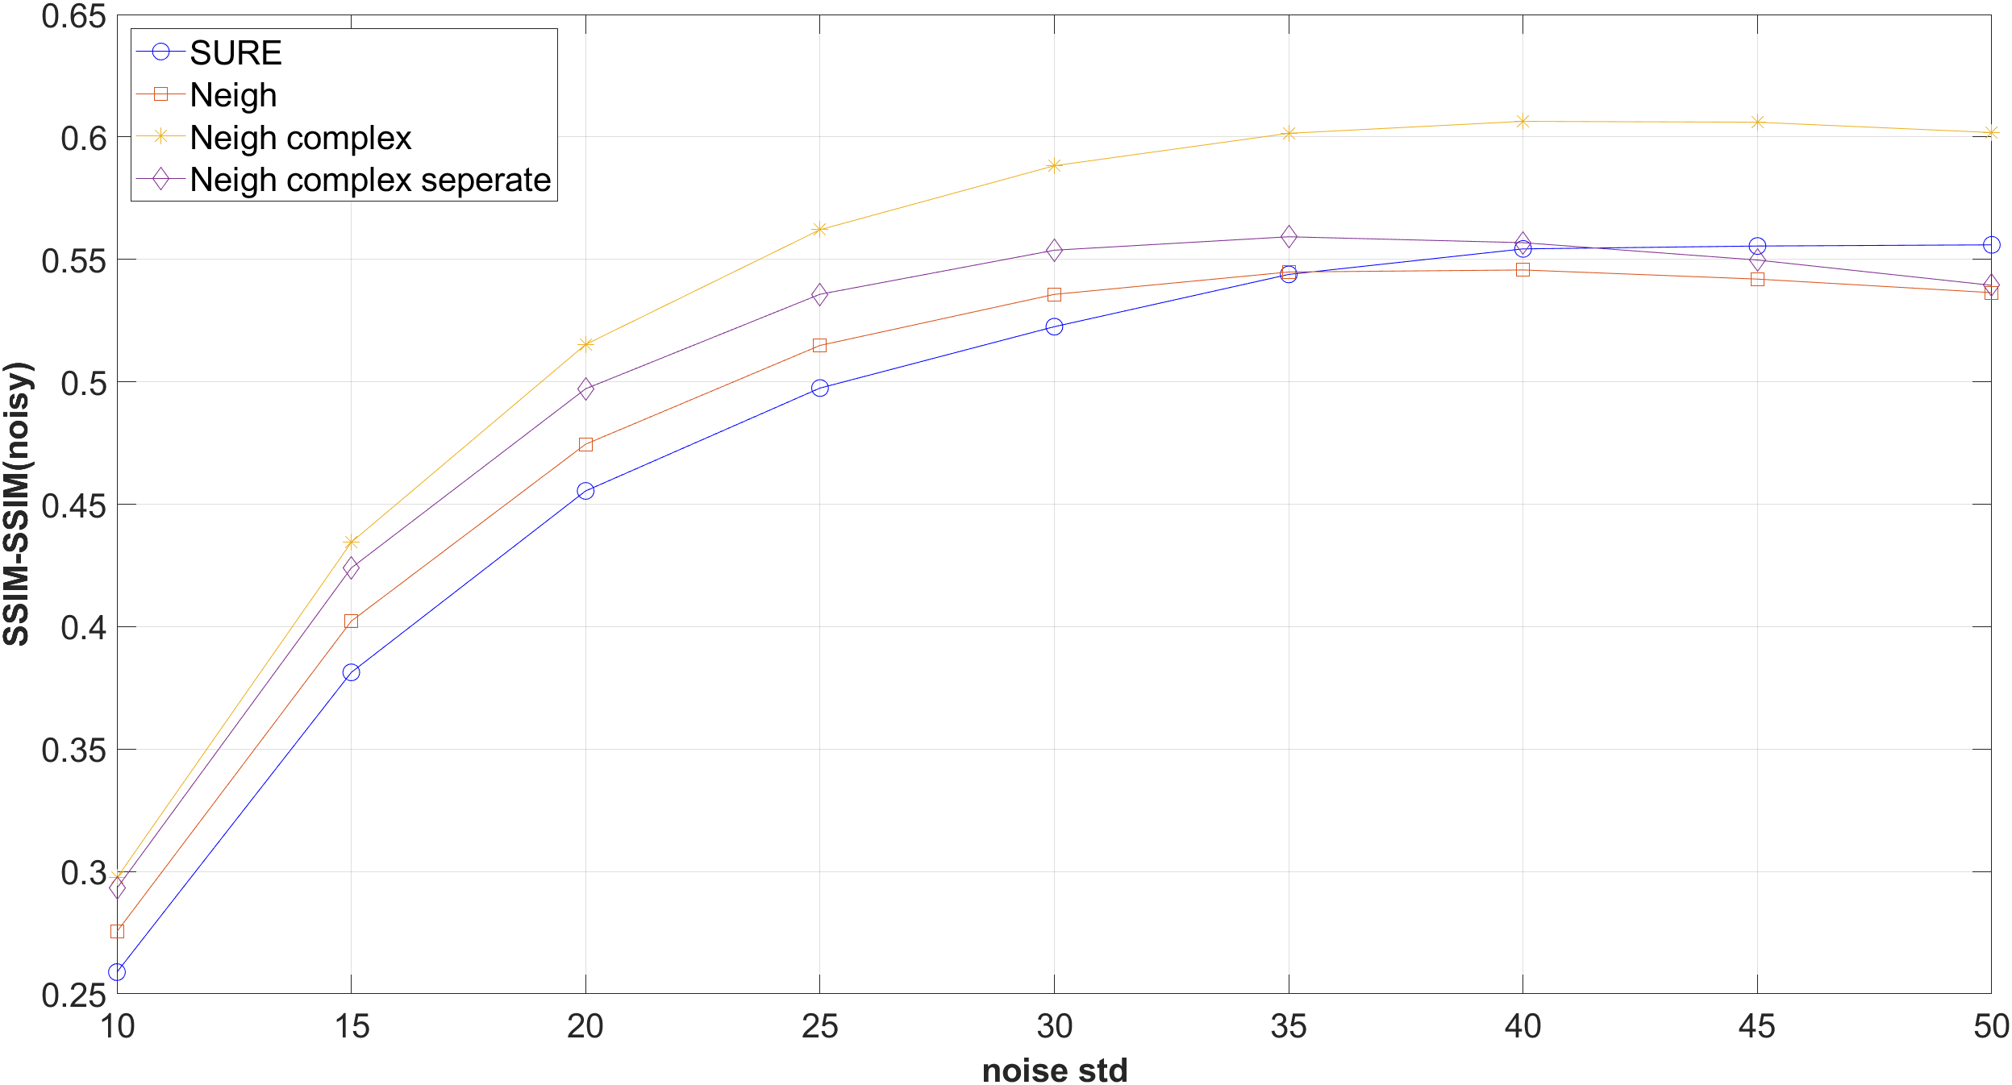
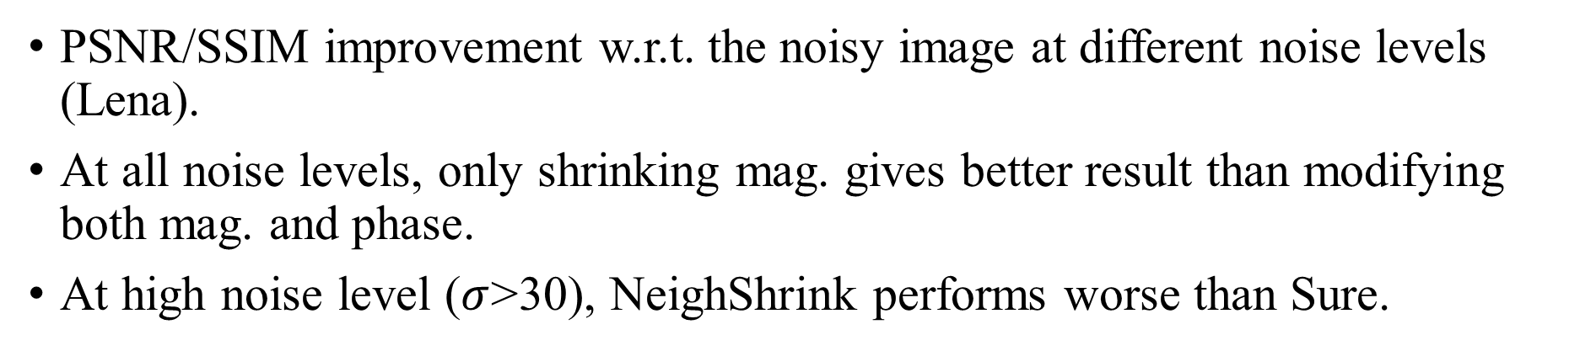
PSNR/SSIM improvement w.r.t. the noisy image at different noise levels (Lena).
At all noise levels, only shrinking mag. gives better result than modifying both mag. and phase.
At high noise level ($σ$>30), NeighShrink performs worse than Sure.

Slide 15
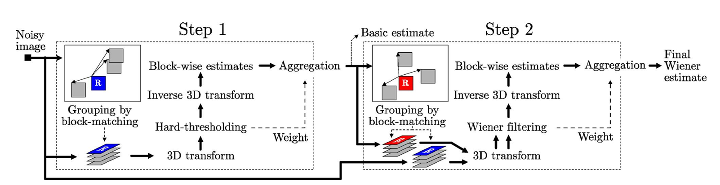
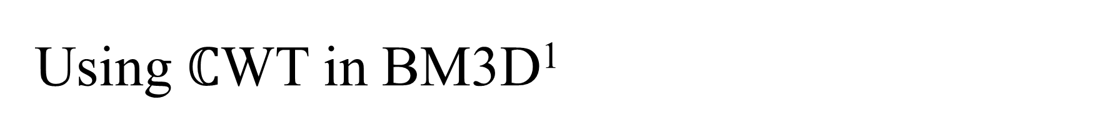
Using $ℂ$WT in BM3D¹
Block Matching 3-D filtering: one of the most effective denoising method.
Flowchart of the BM3D algorithm¹
Collaborative filtering

Slide 16
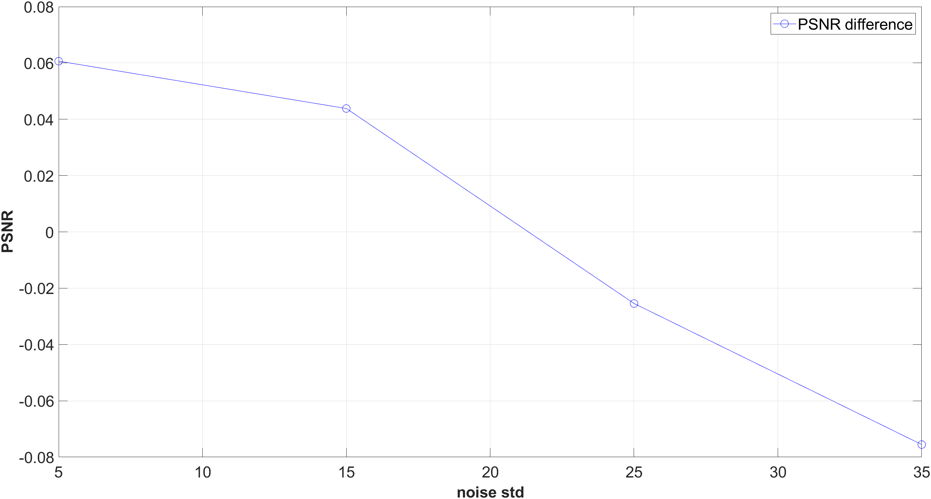
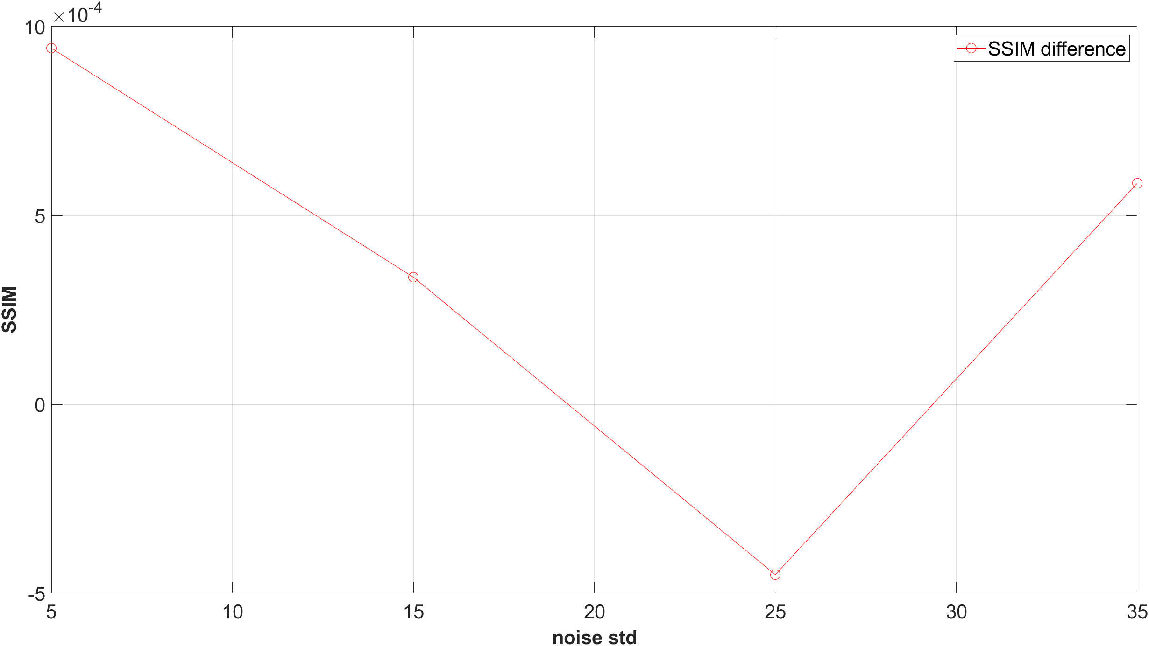
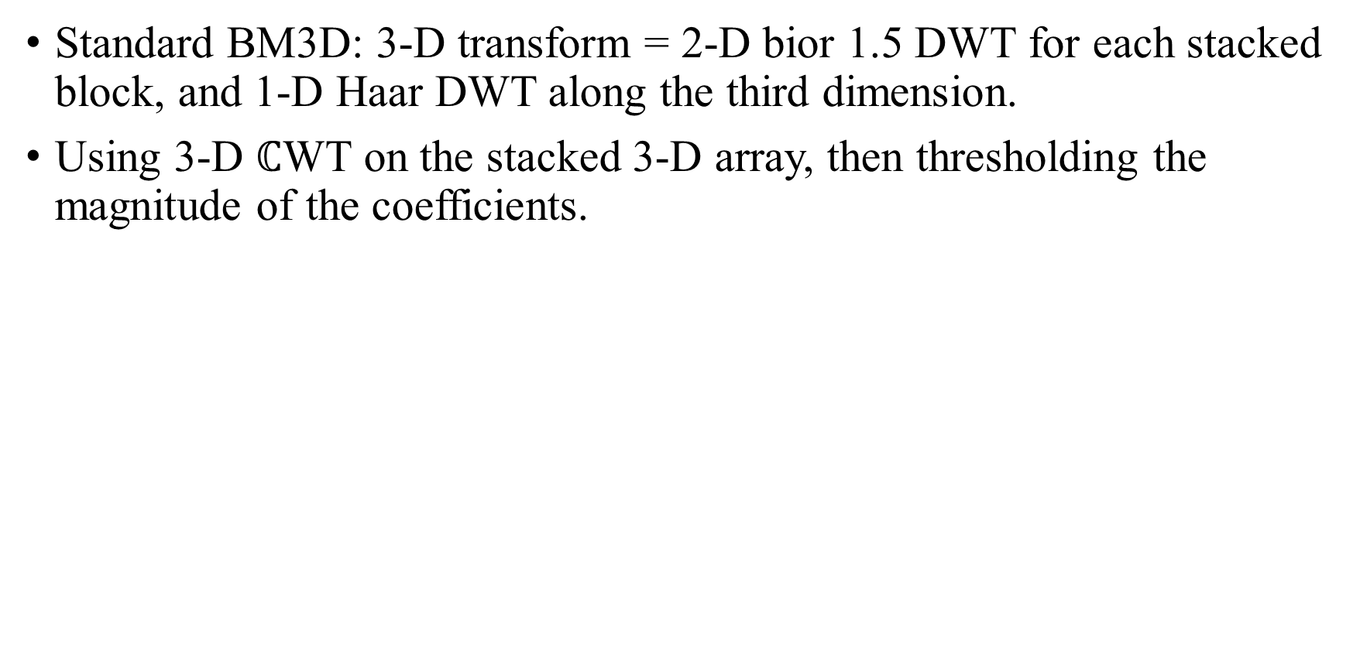
Standard BM3D: 3-D transform = 2-D bior 1.5 DWT for each stacked block, and 1-D Haar DWT along the third dimension.
Using 3-D $ℂ$WT on the stacked 3-D array, then thresholding the magnitude of the coefficients.

Slide 17
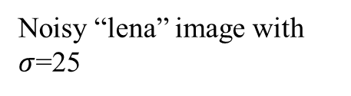
Almost no difference in terms of PSNR and SSIM.
Possible reason: collaborative filtering mainly depends on the similarity among grouped blocks along the third dimension.
As long as the transform along the third dimension can capture this similarity (DC basis element), there’s no big difference.
1-D Transform along the third dimension | PSNR
Haar | 32.08
db2 | 32.06
db4 | 32.06
db6 | 32.06
Bior1.3 | 32.06
Bior1.5 | 32.06
Noisy “lena” image with $σ$=25

Slide 18
Summary
Implemented and compared SureShrink, NeighShrink, bivariate shrink and BM3D.
Extended NeighShrink and bivariate shrink to complex wavelet transform.
Applied complex wavelet transform to BM3D.
Complex wavelet transform is suitable for analyzing oriented singularities in 2-D images.

